Slide 1
Analytical Methods : ANOVA
Discover Right

Slide 2
Topics
ANOVA Basics
Logic and Fundamentals
PROC ANOVA
Illustration : PROC ANOVA

Slide 3
ANOVA Basics
Analysis of Variance is abbreviated as ANOVA which analyzes experimental data in which dependent quantity is varied by changing experimental conditions
Test leverages the fact that variances may be partitioned
ANOVA can be performed with multiple factors (Multi Factor ANOVA)
ANOVA also tests the interaction effects between variables which t-tests can not do
The basic ideas and principles of ANOVA may be extended to continuous variables and Multivariate Designs resulting in ANCOVA, MANOVA and MANCOVA

Slide 4
Logic and Fundamental
Basic fundamental is to partition the total difference in variance into variance difference due to random error (also known as within group SS) and variance difference due to mean difference
(SS)_{Total} = (SS)_{Error} + (SS)_{Mean}
(SS)_{Error} can not be explained in the current scenario and hence attributed to the Random Error (Mean Square Error)
(SS)_{Mean} can however be explained which is due to the effect of partition and hence mean difference hence also called (SS)_{Effect} (Mean Square Effect)
F Value = {(SS)_{Mean}/(DF) _{Mean}}/{(SS)_{Error} /(DF) _{Error}}
Higher F implies lower p-value meaning a significant difference in mean’s

Slide 5
Logic and Fundamental
SS Error is very small compared to SS Mean hence Mathematics and Physics Means are really different and not a matter of chance

Slide 6
Logic and Fundamental
If multiple factors influence the quantity being studied then variability could be attributed to
Within group variance (Error Variance)
Variability due to each factor
Interaction
Independent samples : between-groups factor
Dependent samples : repeated measure or within subject factor
Equal number of observations at each level means balanced data else the data is called unbalanced
PROC ANOVA is used in SAS for balanced data and PROC GLM for unbalanced data

Slide 7
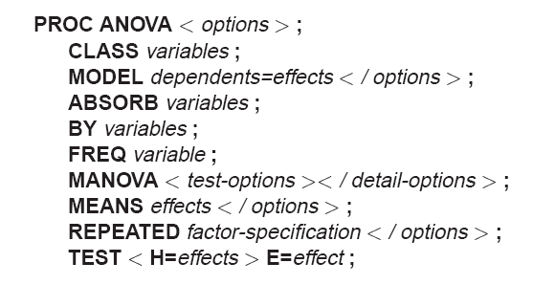
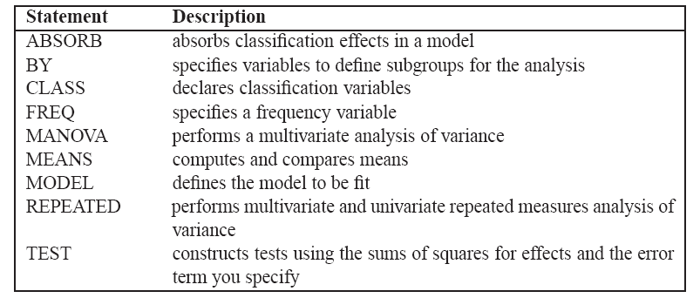
PROC ANOVA
First three statements PROC ANOVA,CLASS, MODEL are mandatory and must precede RUN statement

Slide 8
Illustration
Data is based on the study of three different treatments on the crop yield and its worth
They believe that the blocking units aren't homogenous hence a factor for Block is introduced
Data is being read from the data-step itself hence the datalines statement

Slide 9
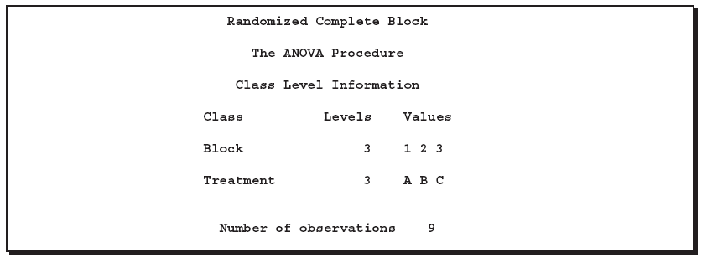
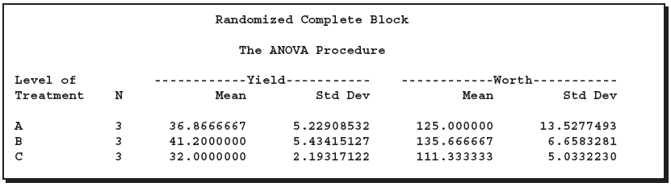


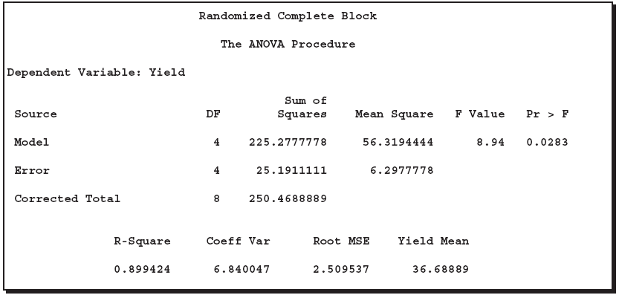
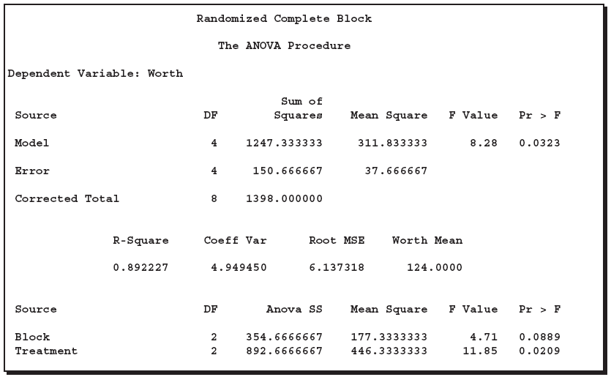
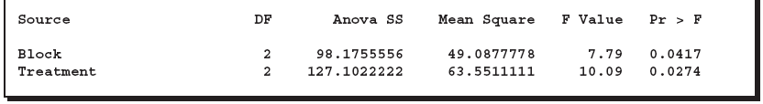
Illustration

Slide 10
Illustration
No of different values of Block i.e. 1,2,3
No of different values of Treatment i.e. A,B,C
Total No of observations in the dataset
Total degrees of freedom of the model = (3-1)+(3-1) = 4 i.e. 3 from Block and 3 from Treatment
Corrected Total degrees of freedom in the dataset = (9-1) i.e. 1 less Total Observations

Slide 11
Illustration
Within group variance or -SS_{Error}
F Value = {(SS)_{Mean}/(DF) _{Mean}}/{(SS)_{Error} /(DF) _{Error}}
Total variance SS_{Total}
Sum of square by degree of freedom
R - Square = (SS_{Total} -SS_{Mean})/(SS_{Total})
Arithmetic Mean of Yield
Variance /Mean
(SS)_{Mean Treatment} ignoring Block subtracted by Error Term
(SS)_{Mean Block} ignoring Treatment subtracted by Error Term
Higher the F-Value the higher is the chance that the means are different

